Slide 1
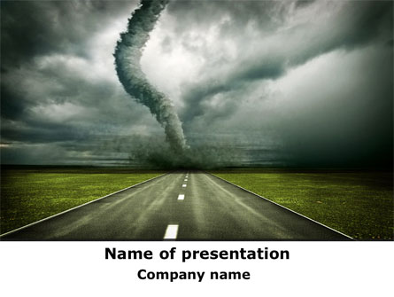
THE OZ PROJECT
MEGHAN LUOMA, KERRY WEHNER, KIRBY MILLER AND SARA RIGGS

Slide 2
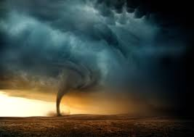
This Oz report will relay Tornado and weather information using OpenWeatherMap API and information from National Oceanic and Atmospheric Administration (NOAA) csv download of 500 tornadic event details from November 1, 2019 to November 30, 2020. The report will utilize HTML, CSS, Javascript and a created SQLite database.
The report will include visualizations utilizing D3.js and Leaflet Map. The d3 visualization will be an interactive scatter plot and will allow users to see choice of Tornado Magnitude or EF scale and resulting Damage, Injuries or Deaths.
Inspiration for Project Oz comes from the recent Tornado Safety Week.

Slide 3
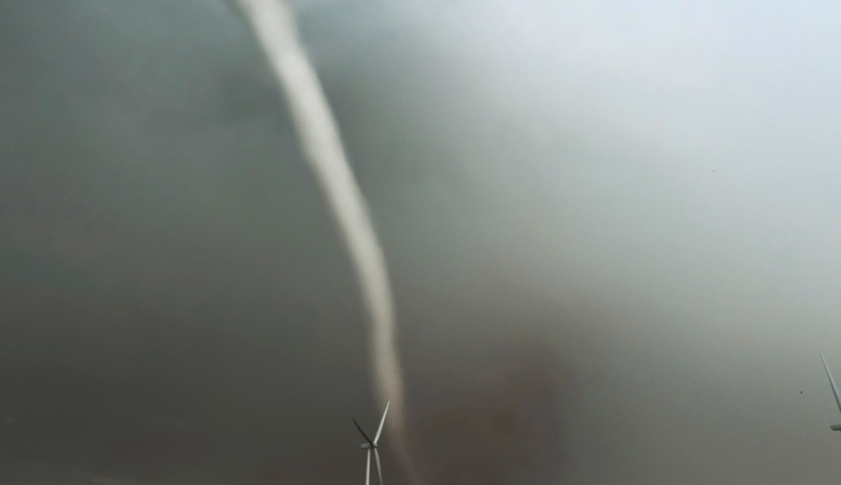
Our hypothesis was very data driven. After reviewing the NOAA data we found data points to compare.
We wanted to see the size and strength of a tornado event compared to the resulting damage. We used a scatter plot to visualize this comparison.
Is there any correlation between size and strength of tornado activity to resulting Death, Injury and Damage?
We also created a map to see where the tornadoes occurred. Which was interesting because there were no tornadoes in Kansas. We also were able to see the direction of the tornadoes.
Where is the most tornadic activity?
Using our API Weather information, we compared tornado strength (EF scale) and size to location. As well as current weather information by location to help predict tornadic activity.
Does location effect size?
Is there current weather indicative to tornadic activity?

Slide 4
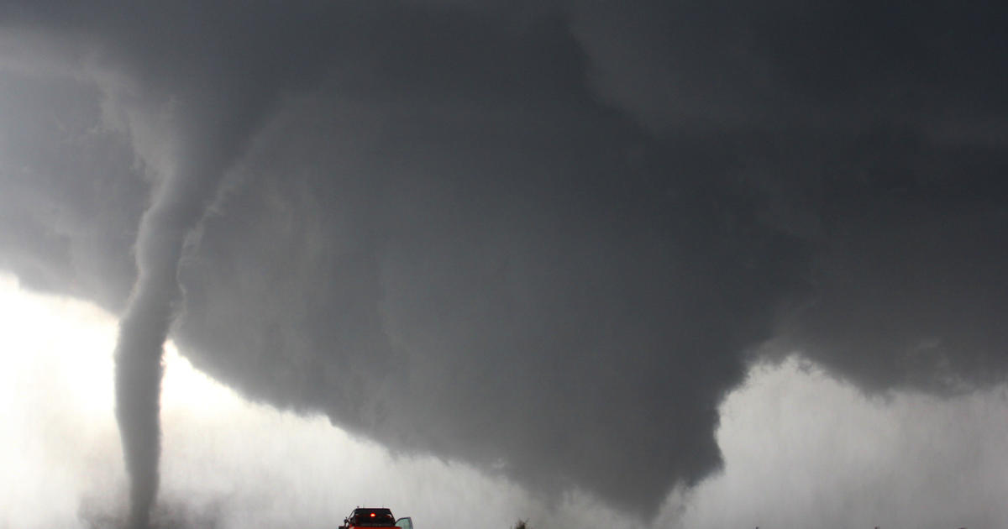
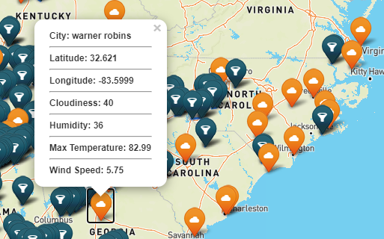
The Leaflet map shows the location and path of the tornadoes. The dark blue markers indicate the tornadoes, and the orange markers indicate the current weather for that area.
Using NOAA data csv file, we gathered the beginning latitude and longitude and the end latitude and longitude and plotted it on the map and drew a line from beginning to end to plot the course of the tornado. You will see a line being drawn between two markers to indicate the path of the tornado.
We provided current weather and tornado information using pop ups on the tornado marker and the current weather marker.

Slide 5
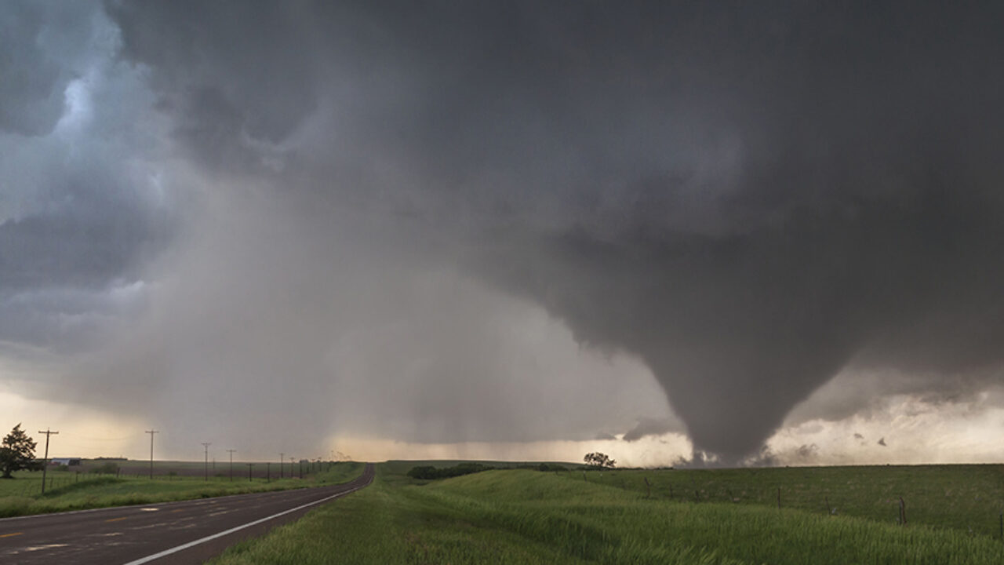
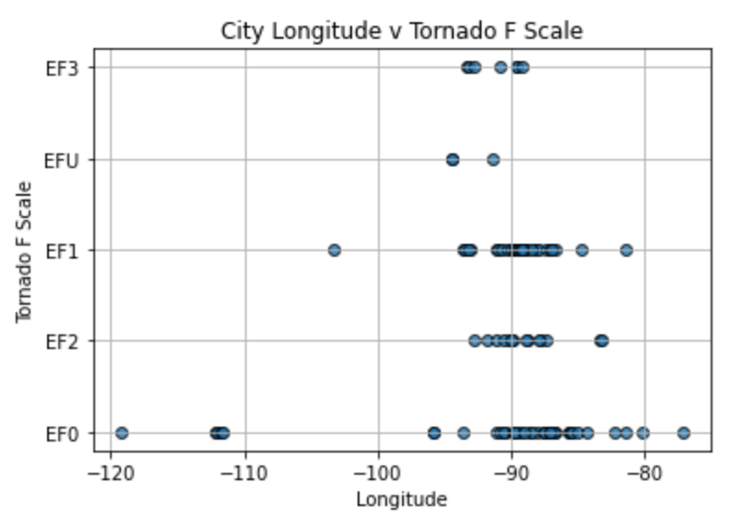
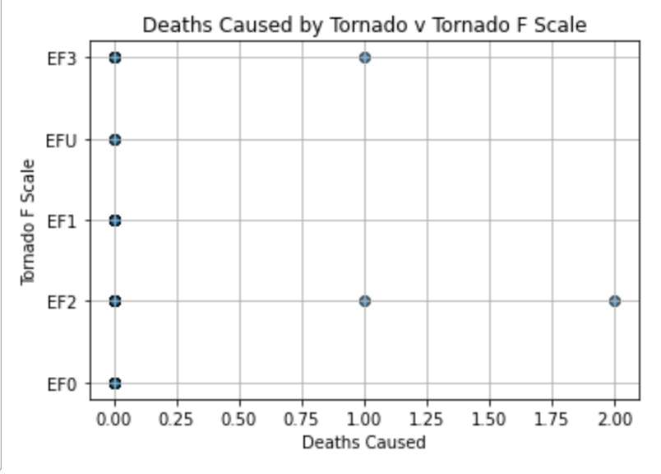
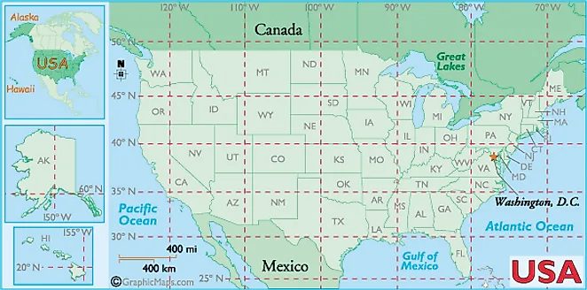
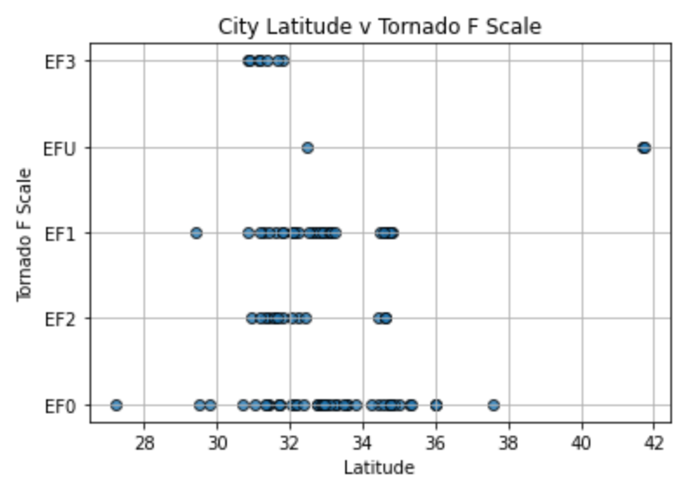

Slide 6
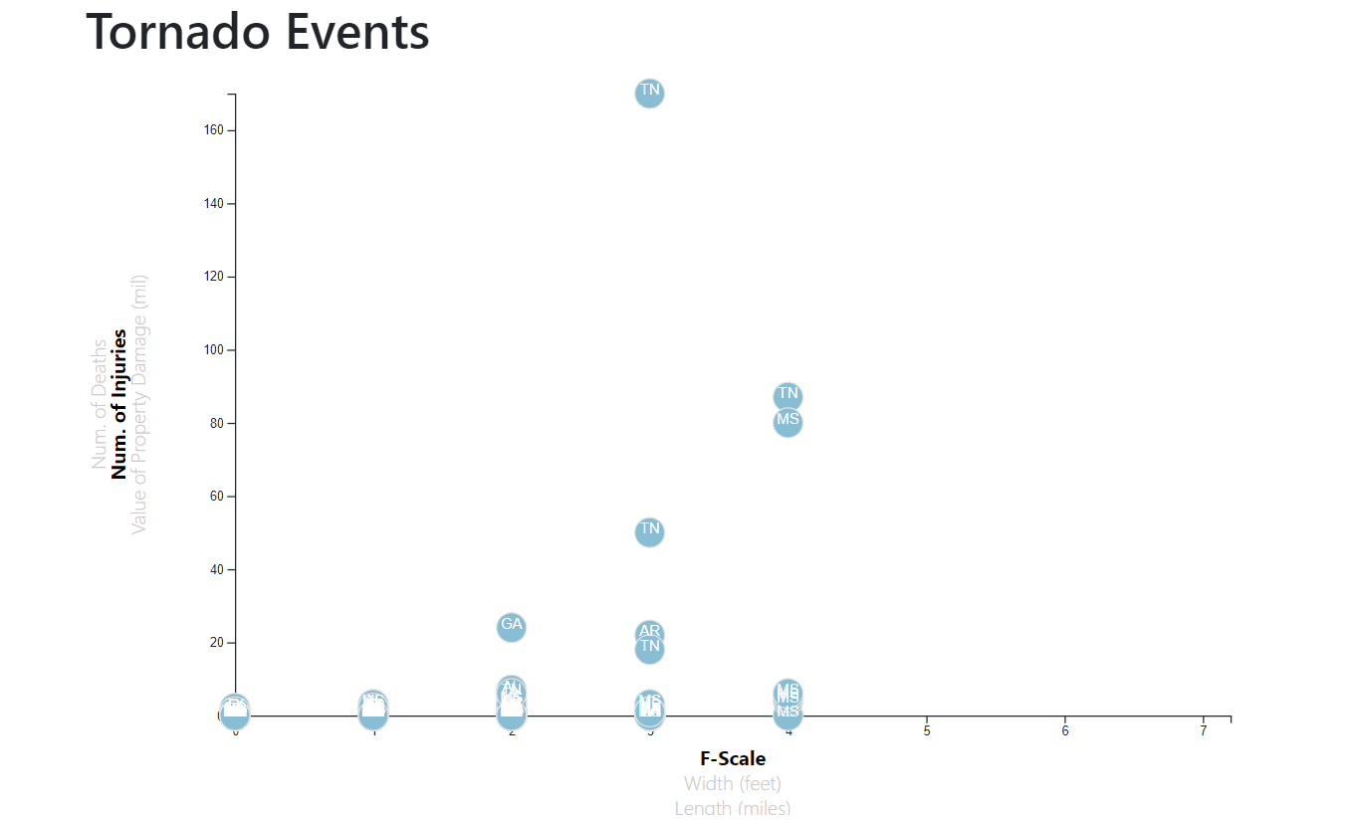
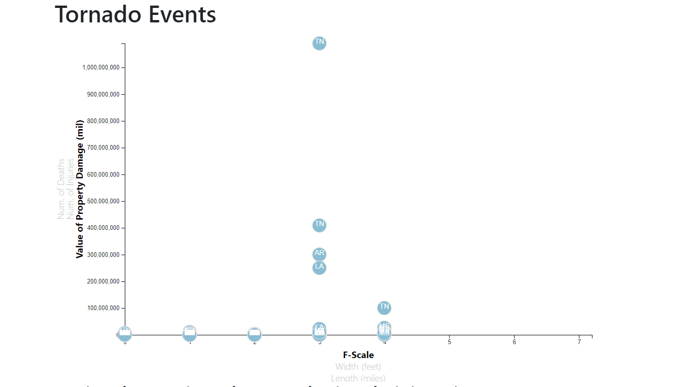
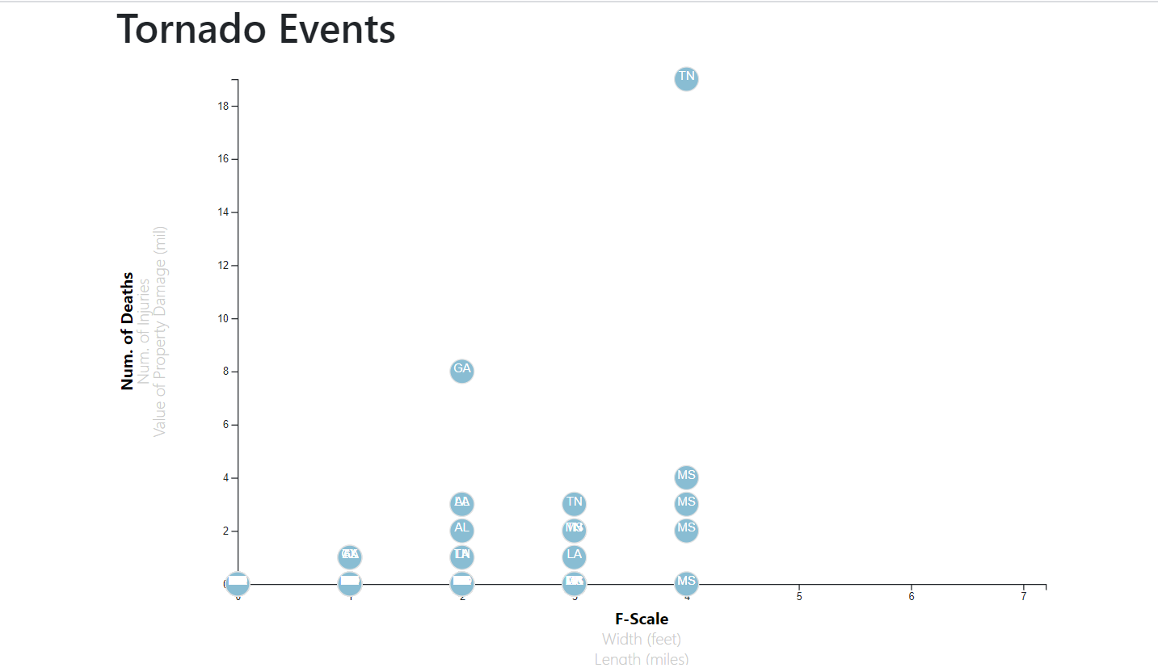
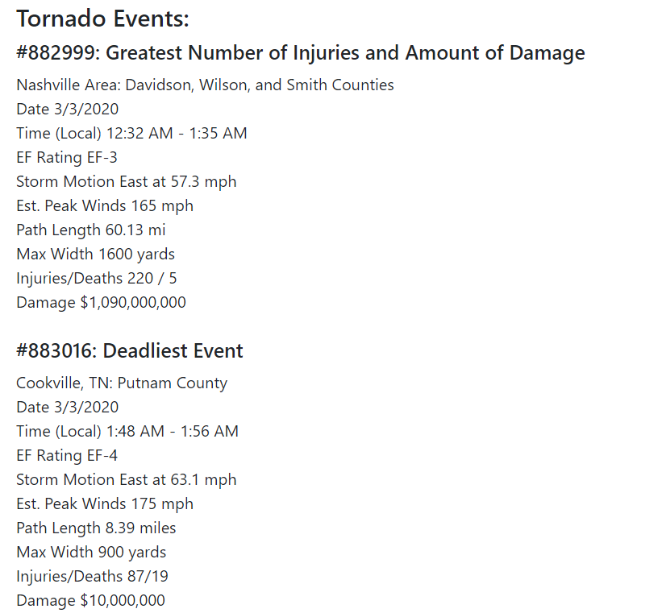
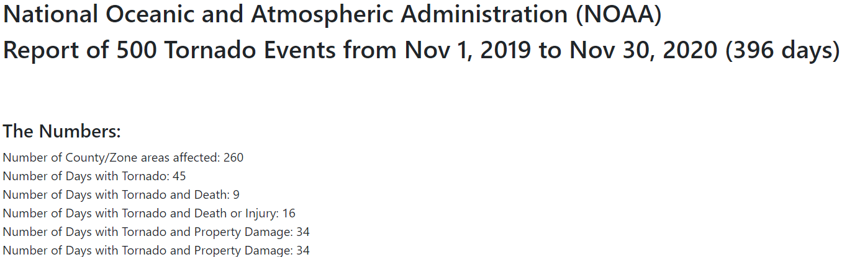
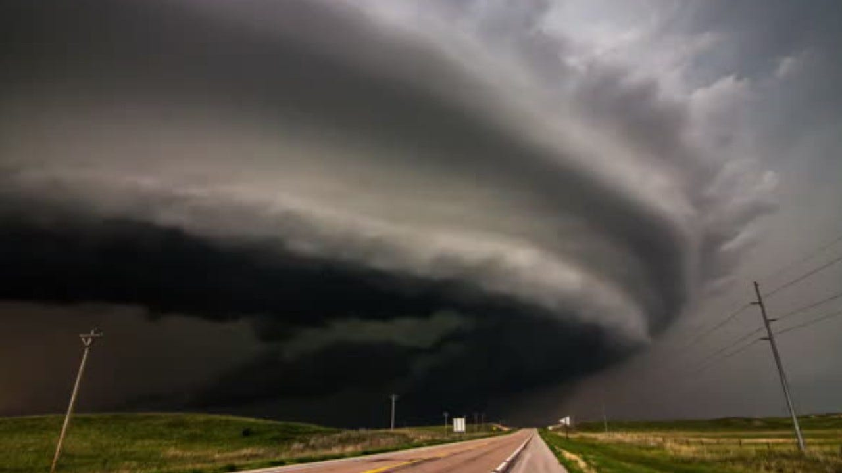

Slide 7
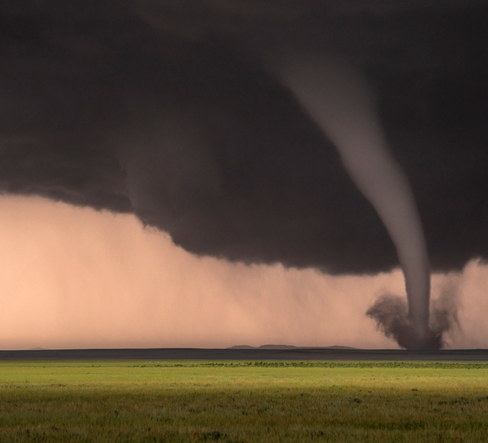
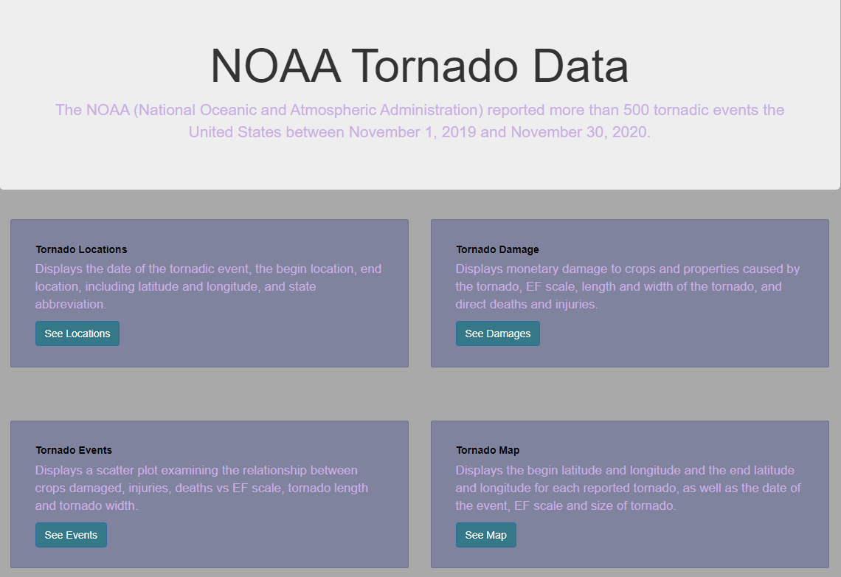

Slide 8
Our conclusions are as follows:
Is there any correlation between size and strength of tornado activity to resulting Death, Injury and Damage?
According to the scatter plot, a tornadic event with the highest EF-Scale resulted in the greatest number in deaths; but a greater number of injuries was from an EF-3 tornadic event, the same of which created the most amount in damage.
Where is the most tornadic activity?
Our analysis of the map shows that Tennessee, Alabama and Mississippi have the most tornadic activity.
Does location affect size?
Since the data is scattered somewhat equally among the EF Scales across latitude and longitude there really is no correlation between location and size.
However, the frequency of tornadic activity along latitude and longitude shows a propensity for tornadoes in certain areas.
Is there current weather indicative to tornadic activity?
This question could be considered for future analysis.

